Slide 1
“But there is a God in heaven who reveals secrets, and He has made known to King Nebuchadnezzar what will be in the latter days. …”
(Dan. 2:28)
All verses are from the NKJV unless noted.

Slide 2
Why I Believe
IN GOD
“But sanctify the Lord God in your hearts, and always be ready to give a defense to everyone who asks you a reason for the hope that is in you, with meekness and fear” (1 Pet. 3:15)
Notes:
How do you answer when you are asked, “Why do you believe in God?” What are the reasons that you give? Some may say, “I just know he is there.” We sing a tune sometimes about knowing God lives because he lives within my heart. While that may be fine to sing, it is hardly giving a defense for the faith within us and for the reality of God. I cannot possibly imagine anyone being convinced by that statement alone. If he is living in our hearts, we should be able to demonstrate logically who God is and why we know he exists from out tongues.
Let me state at first for your patience. I love this subject-material but it so vast that the challenge is reducing this subject into one lesson. My challenge is for you. For every person here I pray this lesson will be of benefit for. Are there any here who do not believe in the existence of God? This lesson may provide you something to consider to move toward faith in God. For the majority here who do believe in God, this lesson should be beneficial in providing extra ammunition and perhaps an extra joist in the framing of your faith.

Slide 3
Belief in God?…I stopped believing in things like UFO’s and the tooth fairy when I became educated!

Slide 4
Scientism
“Belief in the unseen is weird…why should I believe in God? People who pray to something “unseen” are loony.
I won’t believe anything unless I can see it.”
Notes:
Empiricist – views that the only source of knowledge is gained by sensory experience.
Thomas had adopted a strict empirical outlook and was shown that such is not compatible with Christianity (Jn. 20:24-29). This does not mean that we should abandon reasoning and hard facts. What it does require, is that we adapt our outlook with the acceptance of credible testimony (Jn. 20:25, 29).

Slide 5
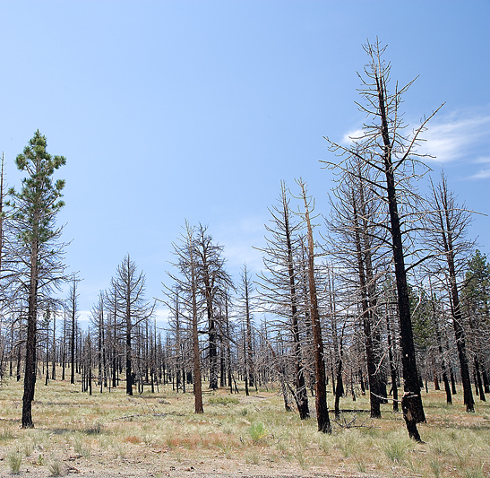
Seeing the Unseen
I Don’t Have To See The FLAMES
To Know They Were In This FOREST
Notes:
All forest fires burn forests. When I find discover a scorched forest; I conclude a fire was there.

Slide 6
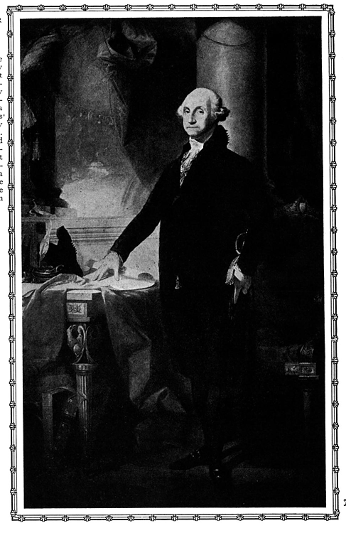
Do You Believe In George Washington?
Do you believe he was our first president?
Do you believe he even existed?
Have you seen him?
Have you heard him?
Have you talked with him?
Notes:
If we live life being governed by a strict scientism, then we will be forced to reject all historical statements. We must accept “credible testimony” to accept history.

Slide 7
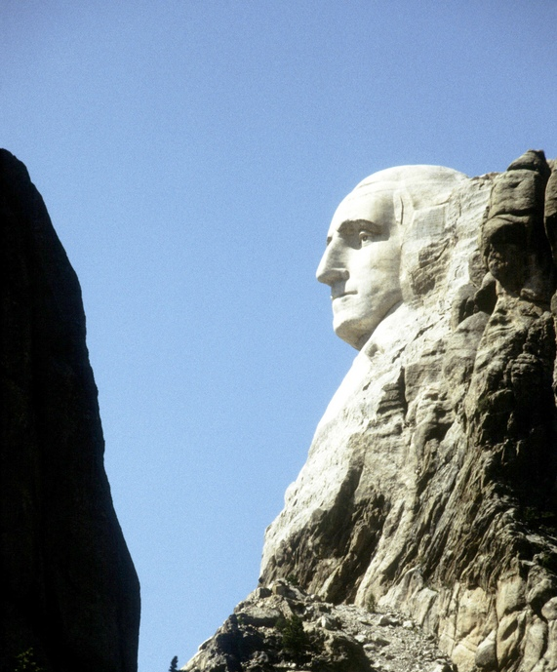
Do You Believe in Mount Rushmore?
Do you believe it is real or a fabrication?
If you believe it real…
Do you believe it was given to us by aliens?
Do you believe it was the product of erosion?
Do you believe it was the product of random and violent explosions?
Do you believe it was designed by intelligence?
Notes:
How many of you believe Mount Rushmore is real? How many of you have seen it? How many of you saw it with your own eyes? More people believe it is real than the number of people who actually saw it? For those of you who haven’t seen it, how do you know the whole Mount Rushmore thing is not just a fabrication? For those of you who have seen it, how did we get it?
Real science can explain “how” Mount Rushmore came into being. Why? Because its formation was observed. The processes, if you will that were at work in its creation were understood and observed. Science cannot tell you why it was built? It cannot really speak of its purpose. A knowledge of history, the history of the images, grants us the understanding of the purpose in its creation.
The same thing is true about our world and the reality of complex life, information, etc. Science can tell us how things work, but it cannot tell us why life is here, why information is here, etc. But if we find the image or stamp of God in the creation, and if the bible is in fact of divine origin, then we can understand the purpose of the universe and of life. The Bible answers the “why” of life and so the “how” of it only makes sense to me to be defined in accordance with the “why!” When you lose sight of the why, the how doesn’t carry forth much weight in any meaning or merit. The same is true with Mount Rushmore.

Slide 8
I Believe In God
Because it is natural and reasonable (Rom. 1:20, 21)
Because scientific evidence is compelling
Because alternative answers fail
Darwinism Versus Design?
Because the Bible is His word
If the Bible is the word of God, then God exists
Because Jesus is the Son of God
If Jesus is the Son of God, then God exists
“For every house is built by someone, but He who built all things is God” (Heb. 3:4)
Notes:
[CLICK] Choosing to believe in God is not intellectual suicide. Many who have not thoroughly investigated the claims for faith would think it is. They define faith as something that is “blind” and “bullheaded” despite what facts says. Yet faith is something that moves with facts and does something that mere science does not necessarily compel one to do. Faith compels one to respond to the facts. It is more than knowing history but it is responding from what is in fact historical. It is more than “I’m right and your wrong.” It is what does “right” compel me to do.
Believing in God is reasonable. Paul discusses this in Romans 1:20, 21, “20 For since the creation of the world His invisible attributes are clearly seen, being understood [perceived, sjw] by the things that are made, even His eternal power and Godhead, so that they are without excuse,
because, although they knew God, they did not glorify Him as God, nor were thankful, but became futile in their thoughts, and their foolish hearts were darkened.” Such foolish darkened hearts resulted in 1:28.
Did you notice the natural quality of faith in God. From the creation of the world the invisible attributes of God are clearly seen and understood. It is only natural to hear the creation scream out that there is a creator! Faith doesn’t just accept that but faith responds to it. Paul condemned the Gentiles for not responding appropriately to what was naturally known to be true and hence, they did not glorify Him.

Slide 9
Seeing the Invisible Attributes of God From the Creation!
Power/energy, atomic power, heat energy
Extremely Powerful Creator
Living Material
God of Life
Design, Intricacy (universe, body, cellular)
Extremely Intelligent and Creative
The reality of emotions (feelings, love, hate, empathy, justice, etc.)
An Emotional and Compassionate Creator
“For since the creation of the world His invisible attributes are clearly seen, being understood by the things that are made, even His eternal power and Godhead, so that they are without excuse” (Rom. 1:21)

Slide 10
The Forgotten “Origin” of Modern Science
Faulkner, D. R., (2005.) Fingerprints of the Divine Around Us. In Ashton J., Westacott M. (Eds), The Big Argument: Does God Exists? (pp. 27-38). Green Forest, AR: Master Books
“Since God is a God of order and operates by decrees, or laws, it seemed reasonable to the Western mind that God would have created an ordered world that follows consistent and knowable laws. In fact the concept of physical law in science sprung from this assumption. …Thus it is no accident that England in the 17th century was the cradle of modern science. For instance, Francis Bacon (1561-1626) is the father of the scientific method.”
Notes:
Danny Faulkner

Slide 11
The Forgotten “Origin” of Modern Science
Faulkner, D. R., (2005.) Fingerprints of the Divine Around Us. In Ashton J., Westacott M. (Eds), The Big Argument: Does God Exists? (pp. 27-38). Green Forest, AR: Master Books
“…A couple of generations later, the Royal Philosophical Society of London was packed with scientific giants such as Isaac Newton (1642-1727), Robert Boyle (1627-1691), and Robert Hooke (1635-1703). Christianity heavily influenced all the men involved in the birth of modern science. Most of these men assumed that the Creator had endowed His creation with order. If we learned more about the natural world, we could learn more about God’s nature.”
Notes:
This foundational beginning of modern science is generally unknown today. The welcoming and pursuit of the creator in the pursuit of knowledge has now been replaced by hostile hands. Why the shift? The shift occurred by the widespread acceptance of Darwinism in the 19th century. Now the predominate mindset rests upon “scientific materialism” which is the belief that the physical realm is the only real realm.
Or as in the words of Carl Sagan, “The cosmos is all that is or ever was or ever will be.” But is this statement a scientific statement? Not at all, for how can Sagan know what all that ever was or ever will be without himself being a God? But this statement was made to reject any supernatural or metaphysical substance. We should appreciate the limitation of science. That just because something cannot be probed, centrifuged or placed within a flask that it is not real. Thoughts are real, but clearly are not composed of the physical elements. Likewise, the Bible asserts that God is Spirit (Gen. 1:2; Jn. 4:24). Such implies that He is outside the material universe and therefore outside the scope of real science.

Slide 12
1. Design: Cosmological
Can “intelligent design” exist without an “Intelligent Designer?”
“Watch” without a watchmaker?
Not the product of matter and energy alone, but also of intellect
“Footprint” without a foot
Can “order” exist without the choice of an “Arranger?”
“The heavens declare the glory of God; And the firmament shows His handiwork” (Psalm 19:1)
1) Whatever Begins to Exist Has a Cause
2) The Universe Began To Exist
3) The Universe Has a Cause
And I would add…
4) The cause transcends the effect
4a) The cause of the universe transcends the composite of the universe (viz. matter, space, time)
Notes:
The study of the heavens declares there is a Creator! “Failing to see handcrafted design in our surrounding environ is indeed one of the saddest and most myopic mistakes a man can ever make” (Joshua Gurtler, manuscript of evolution).
It seems like in our life about everything has a beginning. Our life, our day, our marriage, our job, etc. all had a beginning. Even many things that look the same through life had a beginning. The Sun for example uses up millions of tons of its mass ever single second. That fact that it and the stars are being used up proves that they, and the universe had a beginning.
Al-Ghazali (1058-1111) formulated that whatever begins to exist has a cause; the universe began to exist; therefore the universe has a cause. Please consider what offers more plausibility to origins. The Atheist, Quentin Smith responds, “the most reasonable belief is that we came from nothing, by nothing, and for nothing” in his debate with William Craig (Theism, Atheism and Big Bang Cosmology, Oxford: Clarendon Press, 1993, 135.). Yet if we came from nothing and for nothing, then all of the statements that we affirm are really products of nothing and therefore no one should have any degree of certainty about anything they affirm. Their whole reasoning process is nothing less than the offspring of nothing and chance.
“This first premise is intuitively obvious once you clearly grasp the concept of absolute nothingness. You see, the idea that things can come into being uncaused out of nothing is worse than magic. At least when a magician pulls a rabbit out of a hat, there’s the magician and the hat!” (William L. Craig as quoted by Lee Strobel, The Case for a Creator, p. 99). If something has a beginning, it must have a cause! Do you ever go to work and worry about something popping out of nothing? Do you ever fret about something popping into your car as you drive down the road? I don’t worry about things popping up in my life from nothing. It is the things that pop up in my life from something that concerns me. What is more reasonable, this premise or the denial?
Yet, a personal, intellectual Cause best fits our understanding of how and why the beginning happened at all. If the original cause was impersonal and unintelligent, how do we explain the existence of intelligence today? If life comes from life (Law of Biogenesis); then should it not also be true that intelligence come from intelligence? And why should we blindly accept that from no intelligence any intelligence could ever come?

Slide 13
That Which Caused the Universe Should Transcend The Universe
Cause of Universe
Time
Space
Qualities of Creator
Eternal
Omnipresent
Matter
Spirit
John 4:24
Jeremiah 23:24
2 Peter 3:8
Job 36:26/Prov. 8:23
Psalm 139:8
Acts 17:24
past
present
future
height
depth
width
solid
liquid
gas
Romans 1:20
ANSWERS: “Who Created God?”
“Is God Still Alive?”
Notes:
2 Pet. 3:8, “But, beloved, do not forget this one thing, that with the Lord one day is as a thousand years, and a thousand years as one day.”
Job 36:26, “Behold, God is great, and we do not know Him; Nor can the number of His years be discovered.”
Prov. 8:23, “I have been established from everlasting, From the beginning, before there was ever an earth.”
Jeremiah 23:24, “Can anyone hide himself in secret places, So I shall not see him?" says the LORD; "Do I not fill heaven and earth?" says the LORD.”
Psalm 139:8, “If I ascend into heaven, You are there; If I make my bed in hell, behold, You are there.”
John 4:24, "God is Spirit, and those who worship Him must worship in spirit and truth.“
Acts 17:24, “God, who made the world and everything in it, since He is Lord of heaven and earth, does not dwell in temples made with hands.”
Asking “Who created God” is the same as asking, “Who created the creator?” Some say that because I assert there was a beginning and God is cause of the beginning then there must be a cause for God. Whatever exists must have a cause. Yet I didn’t assert that “whatever exists” but “whatever begins to exist.” God did not begin to exist as he is over time! It is a endless journey to no where to begin walking down when you begin to interpret infinities in a finite universe. If there is a creator, he doesn’t need created!

Slide 14
To Believe That “Time,” “Space,” and “Matter” Have Always Existed…
Is a faith with no evidence
Is opposed to science and religion
Does not account for the origin of life
Does not account for the origin of intelligence
“There is no ground for supposing that matter and energy existed before and was suddenly galvanized into action. For what could distinguish that moment from all other moments in eternity? It is simpler to postulate creation ex nihilo—Divine will constituting Nature from nothingness”
(Edmund Whittaker, The Beginning and End of the World, Oxford: Oxford University Press, 1942, quoted by: Lee Strobel, The Case For A Creator, p. 111).

Slide 15
“I AM WHO I AM”
Time
Space
Matter
Universe
GOD
Self Existing One
No Beginning
No Cause
beginning
And God said to Moses, "I AM WHO I AM." And He said, "Thus you shall say to the children of Israel, ‘I AM has sent me to you.’“
(Exodus 3:14)
Notes:
God is the only true option of anything known to man that fills the bill.” Even his name in the Hebrew means “Self-existing One.” Please get my point! “Real science and reason calls for a self-existing one.” The Bible, before modern science says there is such a One.

Slide 16
To Create “Time,” “Space,” and “Matter”…
when there was none…
Implies that God has free will
Implies that God is all powerful
Implies that God is creative

Slide 17
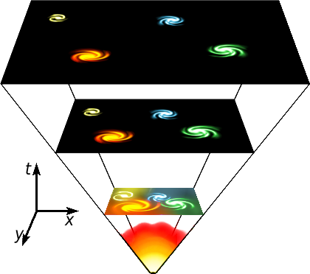
“Facts” of Astrophysics and Cosmology Agree With the Biblical Model
FACT: Expanding Universe (Hubble Law; see Is. 44:24)
FACT: Red Shift (galaxies are moving away)
FACT: Law of Energy Conservation
FACT: Law of Entropy
FACTUAL CONCLUSION: A Beginning!
Manmade Conjectures:
Naturalistic explanations of “the bang”
Sun created before earth
Billions of years
http://en.wikipedia.org/wiki/Image:Universe_expansion2.png
Notes:
The “Big Bang” model is the standard model that is accepted and promoted today. As recent as one hundred years ago, the belief that the universe was infinite was the prevailing scientific model. Even in 1948 the “creation” of the Steady State theory or “Infinite Universe” theory took place. This theory was motivated because of the distaste of the universe having a beginning, yet there was no evidence to sustain that new material was being created, but rather on the contrary via the First Law of Thermodynamics. Anyway, the research that went into prove the Steady State theory essentially falsified it and began to support the so-called “Big Bang.” The final nails were driven into the Steady State Theory in 1965 when Arno Penzias and Robert Wilson discovered background radiation.
As with many theories postulated by men, opinions are often crammed into the package. The big bang theory is still an assumption. That there was a beginning is not assumptive, but an impersonal explosion from which order, life, intelligence emerged is.
Hubble’s Law is that the universe is expanding. Long before Hubble, Isaiah recorded, “Thus says the LORD, your Redeemer, And He who formed you from the womb: ‘I am the LORD, who makes all things, Who stretches out the heavens all alone, Who spreads abroad the earth by Myself’” (Is. 44:24).
Imagine a balloon with dots on it and as the balloon expands the dots separate from each other in distance. Well, going in the reverse in time then the universe would be shrinking. Still, men who remove God out of the equation have sought to come up with explanatory detail to keep their science unpolluted of the supernatural. Rather than seeing God as the beginning of creation, men have postulated a mechanical bang. Yet, even if we grant them the “bang,” one must ask, where did the “bang” come from. If you see a firework explode in the sky, do you ever reason that there was no designer and igniter of that display? Without a cause there is no show.
Also, when properly understood and applied, the laws of energy conservation and entropy mandate that the universe had a beginning. the First Law of Thermodynamics, tells us the total amount of mass-energy in the universe is constant. The second law teaches the amount of energy available for work is running out. So, the universe cannot be eternal if the mass-energy is limited and the usable energy is depleting. It’s end is built within but it also implicates its beginning. If workable energy is running down, then there must have been a time when that supply was given, (like the winding up of a watch).

Slide 18
Reversal
100 years ago nearly all scientist believed the universe was eternal
Christians had to maintain their faith in what was written regarding a finite beginning despite what “scientific professionals” were saying (Gen. 1:1)
Today mainstream science endorses that the universe had a beginning
Atheists must maintain their faith in an eternal universe despite the “current” scientific evidence
Or they must downplay the significance of a beginning

Slide 19
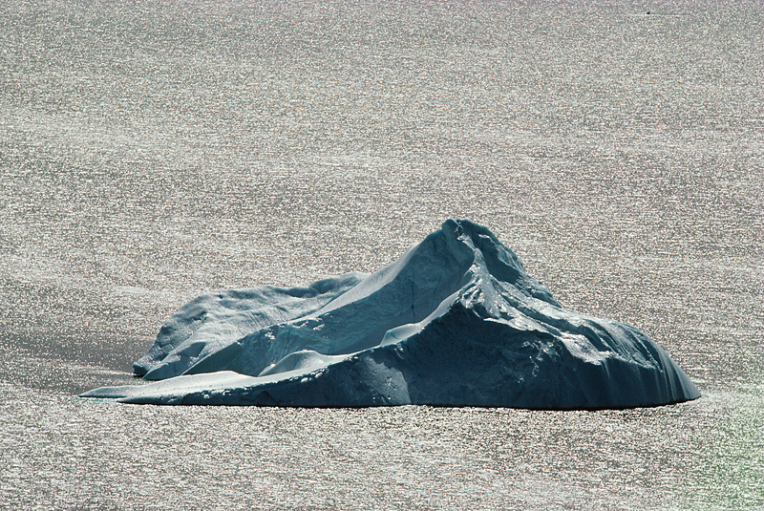
Ever Shifting Sand Versus “The Rock”
The Creation Doctrine
Unchangeable Word of God
“In the beginning God created the heavens and the earth” (Gen. 1:1)
“… who lives forever and ever, who created heaven and the things that are in it, the earth and the things that are in it, and the sea and the things that are in it…” (Rev. 10:6)
“By faith we understand that the worlds were framed by the word of God, so that the things which are seen were not made of things which are visible (Heb. 11:3)
Opinions of Men on Origins
Big Bang?
Steady State?
Oscillating/plasma?
Notes:
[CLICK] Big Bang – To have a “bang” you have to have something there to explode. Further, the inclusion of billions of years and chaos that are often associated with the model make it unacceptable for the one who believes in the unchangeable word of God.
[CLICK] Steady State – Simply denies the beginning of the universe which no Christian can endorse.
[CLICK] The oscillating theory was also built to counter the idea of the universe having a beginning. This would have the universe expanding and contracting like the bladder in an oxygen machine. So instead of a big bang, you would be advocating a big crunches? Anyway some have said that even if the universe were permitted to expand and collapse that each subsequent expansion would be bigger than the previous and so you once again create the same problem that scientist don’t like with the Big Bang—a beginning. As you go back in time then, the crunches would be smaller until eventually you have a beginning.
Further, what would have put the motion of expanding and crunching in order?

Slide 20
“The heavens declare the glory of God; And the firmament shows His handiwork” (Ps. 19:1)
“How?” and “Why?”
COSMOLOGICAL: PURPOSE
“Would it not be strange if a universe without purpose accidently created humans who are so obsessed with purpose?”
(Sir John Templeton, ©1998, The Humble Approach: Scientists Discover God. Philadelphia: Templeton Foundation, p. 19)
Notes:
That the universe had a beginning the vast majority of scientists agree. Folks, it had a beginning for a purpose! There was a beginning for a reason. Only the Bible gives us that answer.
“Why” would the universe care about creating an environment with such narrow parameters and strict conditions to be conducive for life? Science can see that such conditions are met. It struggles in ways to even answer “how” such conditions could be met. But more important than “how?” is “Why?” Now “how” but “why” did the universe come into being? Why was earth formed where such complex life forms are permitted to live?

Slide 21
“The heavens declare the glory of God; And the firmament shows His handiwork” (Ps. 19:1)
Faulkner, D. R., (2005.) Fingerprints of the Divine Around Us. In Ashton J., Westacott M. (Eds), The Big Argument: Does God Exists? (pp. 27-38). Green Forest, AR: Master Books
COSMOLOGICAL: FINE TUNNING
“The universe does not care whether the values and conditions that exist in the universe are conducive to life. One therefore must ask what range of values and conditions the universe could have that would make life possible and then assess the probability of the universe to exist within this range. The conclusion is that our universe is remarkably improbable and appears fine-tuned.”

Slide 22
“The heavens declare the glory of God; And the firmament shows His handiwork” (Ps. 19:1)
Faulkner, D. R., (2005.) Fingerprints of the Divine Around Us. In Ashton J., Westacott M. (Eds), The Big Argument: Does God Exists? (pp. 27-38). Green Forest, AR: Master Books
COSMOLOGICAL: FINE TUNNING
“If the initial expansion rate was infinitesimally less than just right, the universe would have quickly re-contracted upon itself. If the expansion rate were slightly greater, the universe would have rapidly expanded to such low density that no galaxies, stars, planets, or people would exist. Either way, we would not be here.”
Notes:
Danny Faulkner is speaking against a purely natural big bang as the origin of the universe. The only thoroughly reasonable conclusion is the conclusion long ago inscribed in Ps. 19:1.

Slide 23
The Cosmos Required Intelligent Input!
CONCLUSION:

Slide 24
THE PLAN FOR
YOUR SALVATION
Hear the Word of God---Rom. 10:17
Believing In Your Heart---Heb. 11:6
Repenting Of Your Sins---Acts 2:38
Confess That Christ Is The Son of God--- Rom. 10:10; Acts 8:37
Be Baptized Into Christ---Gal. 3:26-29
Be Faithful Until Death---Rev. 2:10; I Cor. 15:58

